Slide 1



Studying Thermal Activity in Yellowstone using Satellite-based Thermal Infrared Remote Sensing
Dane Henderson (NAU)
Mentor: R. Greg Vaughan (USGS / NAU)
Notes:
Hi, my name is Dane Henderson, a sophomore at NAU majoring in Geology/Geophysics, and I have been working with Dr. Greg Vaughan of the U.S. Geological Survey on “Studying Thermal Activity in Yellowstone using Satellite-based Thermal Infrared Remote Sensing”

Slide 2
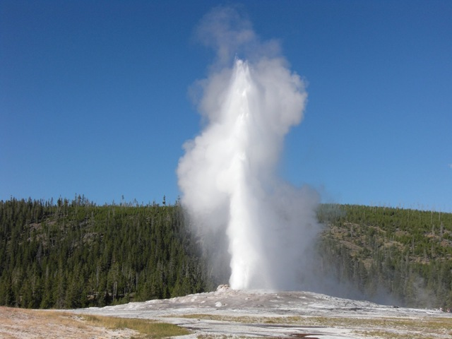
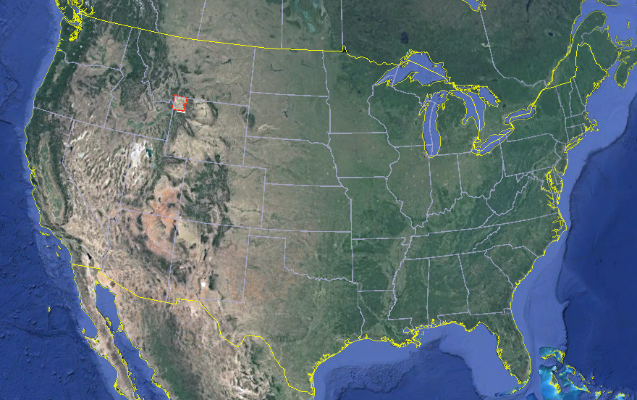
Yellowstone National Park Geothermal Area
World’s largest geothermal area
Potentially active volcano
Geologic activity is monitored for Park development, visitor safety, and to assess future volcanic potential
Notes:
Located in NW Wyoming, Yellowstone is famous for its geysers and hot springs. It is the world’s largest geothermal system, with more than half of the world’s geysers and thousands of other thermal features (like boiling hot springs and gas vents). In fact, this is the reason it was made the world’s first National Park in 1872. It is also a potentially active volcano that has had some very large volcanic eruptions in the past. So monitoring geologic activity in Yellowstone is important to support decisions about Park development, visitor safety, and to assess future volcanic potential.

Slide 3
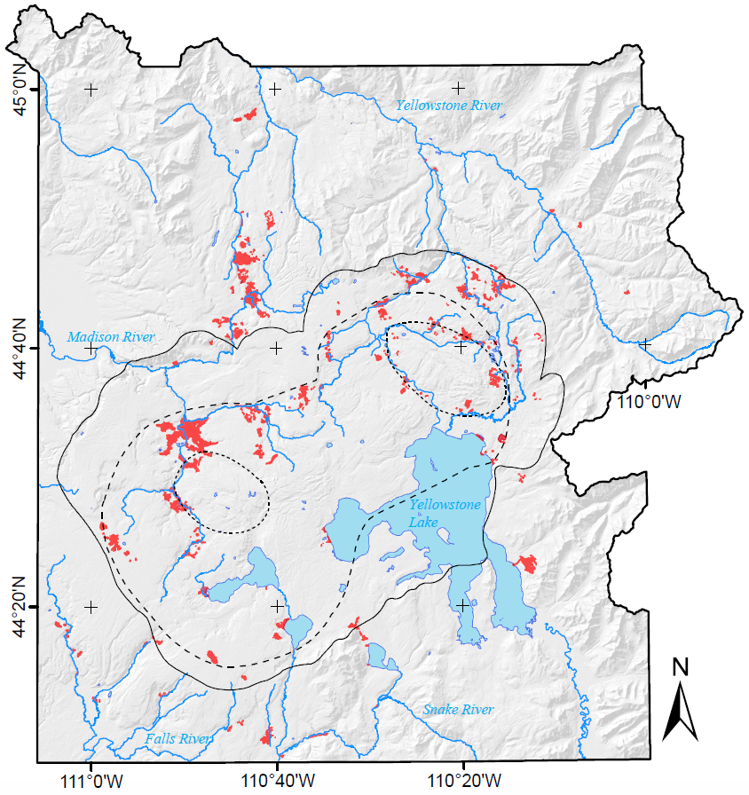

Yellowstone National Park Geothermal Area
Thermal Area Maps
Lakes
Thermal Areas
Volcano Monitoring
  Earthquakes
  Ground Deformation
  Gases / water chemistry
  Thermal Characteristics
    (temperature and heat flux)
Yellowstone Caldera
0
10 mi
0
10 km
Notes:
The purpose of regular monitoring is to establish normal background characteristics, so that we know how to recognize abnormal activity should it ever occur – changes that could indicate renewed volcanic activity. There are generally 4 things that are monitored regularly (list them).
Most of these things require periodically putting people and instruments in the field.

Slide 4
Yellowstone National Park Geothermal Area
Thermal Area Maps
Lakes
Thermal Areas
Volcano Monitoring Challenges
  Large area
  Rugged, inaccessible, dangerous
Yellowstone Caldera
Solution
  Remote Sensing
  Thermal Infrared images can measure surface temperature
0
10 mi
0
10 km
Notes:
But Yellowstone is a very large area, about 100 km by 90 km in area. And most of the land, including most of the thermal areas (shown on this map in red), is rugged, inaccessible, and sometimes dangerous (think grizzly bears!). So, it’s not feasible to regularly monitor all of these things using field-based instruments.
Fortunately, one of the important things to monitor (surface thermal activity) is something that can be measured remotely (from aircraft or space craft) using thermal infrared imaging technology. So, one solution is to use satellite-based remote sensing tools to observe and measure the surface thermal characteristics.

Slide 5
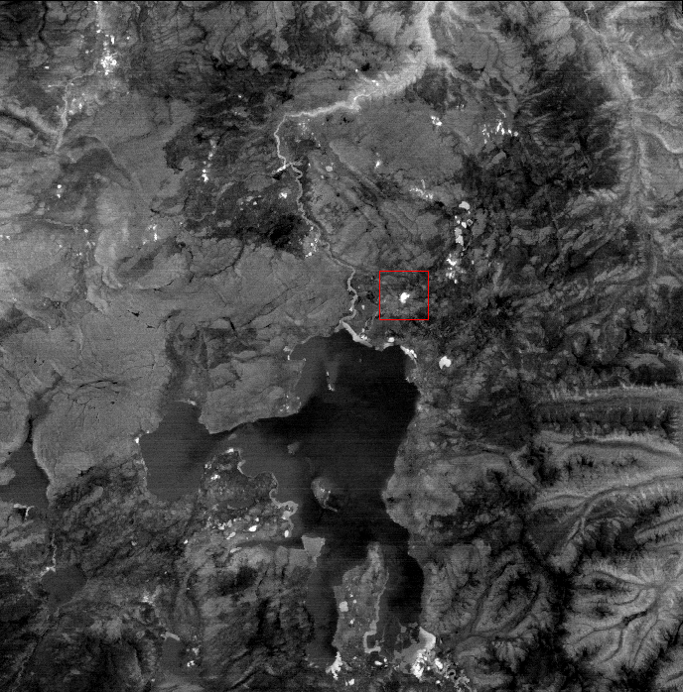
Data & Methods
ASTER Thermal Infrared Imagery
  (Thank you NASA/JPL)
TIR = Wavelength between 8 & 12 microns
90 meter pixels
Sulfur Hills
Turbid Lake
ASTER nighttime TIR temperature image from May, 2012. Bright areas are the warmest.
Notes:
So, I have been using thermal infrared (TIR) images from the Advanced Spaceborne Thermal Emission and Reflection Radiometer (ASTER).
Thank you to NASA and JPL for providing these data for free!
By TIR, I mean electromagnetic radiation with wavelengths between about 8 and 12 microns.
ASTER TIR data have 90-m pixels, and in this ASTER image, acquired at night in May, 2012. Bright pixels are warmer and dark pixels are colder. In May, normal nighttime surface temperatures in Yellowstone are about -0 °C (freezing), and the thermal areas (point to them) have pixel temperatures that range from 10 – 40 C above the background. Here is Yellowstone Lake - it is dark because in May it is still frozen – covered in ice. And here are the two thermal areas that I focused on: Sulfur Hills and Turbid Lake, each about 700 m across. Sulfur Hills is an area with hundreds of small boiling gas vents where dry, sulfur-rich gases are coming out at about 93 °C (which is the boiling temperature at elevations in Yellowstone). Turbid Lake is an old explosion crater filled with water that is kept warm by underwater vents.

Slide 6
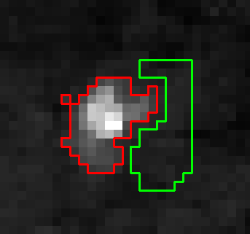
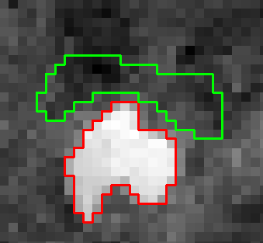
Data & Methods
Sulfur Hills
Turbid Lake
Thermal Area
Background Area
Stefan–Boltzmann law:
Heat Flux = σ * ε * T⁴
Notes:
The energy that is measured radiating from the surface is primarily a function of the surface temperature. So these data can be used to measure surface temperature and make surface temperature maps. But another important value to measure is radiant heat flux (measured in W/m²). This can be calculated from surface temperature using the Stefan–Boltzmann law (Heat Flux = sigma * emissivity * T⁴).
Now some of the heat radiating from the surface is due to absorbed sunlight and some of it is geothermal (coming from underneath). To isolate just the geothermal part, I calculated the heat flux from the thermal areas and subtracted the heat flux from a nearby, non-thermal background area.

Slide 7
Results
Sulfur Hills
Turbid Lake
# Hot Pixels | 73 | 109
Max. Pixel Temp | 41 °C | 11 °C
Avg. Pixel Temp | 17 °C | 8 °C
Geothermal Radiant Heat Flux | 80 W/m² | 40 W/m²
Notes:
And here are the results.

Slide 8
Conclusions & Future Work
Satellite TIR remote sensing data are very important for thermal monitoring in Yellowstone
These data can be used to
  Assess and update maps of thermal areas
  Create thermal anomaly maps
  Quantify and monitor changes in thermal activity
Future plans
  Assess the difference between using day time and night time TIR imagery
  More thermal mapping on different dates
  Add these results to the on-going thermal monitoring database
Notes:
Daytime observations are more difficult to interpret due to

Slide 9


Acknowledgments
NASA / NAU Space Grant
NASA / JPL ASTER Science Team
Dr. R. Greg Vaughan
Support of Family and Friends

